Slide 1
CSCI-351 Data communication and Networks
Lecture 10: Inter Domain Routing
(It’s all about the Money)
The slide is built with the help of Prof. Alan Mislove, Christo Wilson, and David Choffnes's class

Slide 2
Network Layer, Control Plane
Function:
Set up routes between networks
Key challenges:
Implementing provider policies
Creating stable paths
Data Plane
Application
Presentation
Session
Transport
Network
RIP
OSPF
BGP
Control Plane
Data Link
Physical

Slide 3



ASs, Revisited
AS-1
AS-3
Interior Routers
AS-2
BGP Routers

Slide 4
AS Numbers
Each AS identified by an ASN number
16-bit values (latest protocol supports 32-bit ones)
64512 – 65535 are reserved
Currently, there are > 60000 ASNs
AT&T: 5074, 6341, 7018, …
Sprint: 1239, 1240, 6211, 6242, …
RIT: 4385,
North America ASs → ftp://ftp.arin.net/info/asn.txt
bgp.he.net is a good tool

Slide 5
Inter-Domain Routing
Global connectivity is at stake!
Thus, all ASs must use the same protocol
Contrast with intra-domain routing
What are the requirements?
Scalability
Flexibility in choosing routes
Cost
Routing around failures
Question: link state or distance vector?
Trick question: BGP is a path vector protocol

Slide 6
BGP
Border Gateway Protocol
De facto inter-domain protocol of the Internet
Policy based routing protocol
Uses a Bellman-Ford path vector protocol
Relatively simple protocol, but…
Complex, manual configuration
Entire world sees advertisements
Errors can screw up traffic globally
Policies driven by economics
How much $$$ does it cost to route along a given path?
Not by performance (e.g. shortest paths)

Slide 7
BGP Relationships
Provider
Peer 2 has no incentive to route 1→ 3
Peers do not pay each other
Customer
Provider
Customer
Peer 1
Peer 2
Peer 3
Customer pays provider
Customer

Slide 8
Tier-1 ISP Peering
Inteliquent
Centurylink
Verizon Business
AT&T
Level 3
Sprint
XO Communications

Slide 9
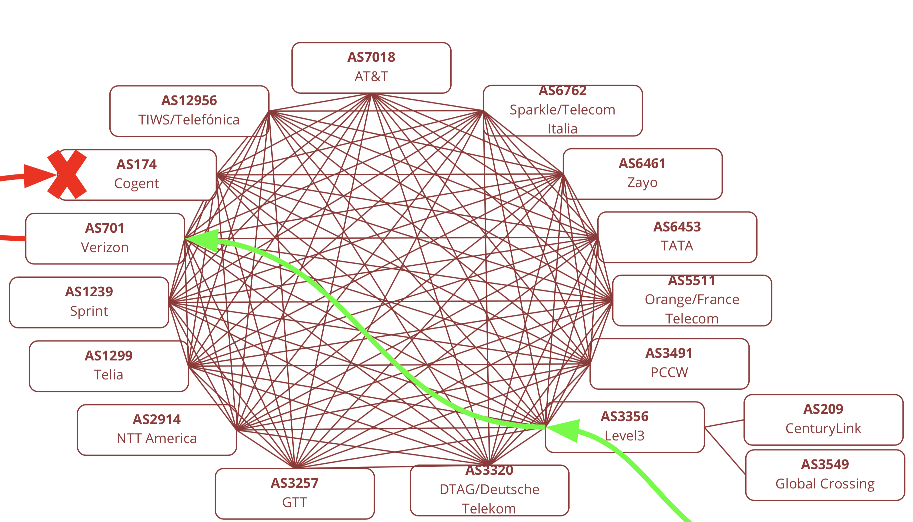
Tier-1 ISP Peering
Inteliquent
Centurylink
Verizon Business
AT&T
Level 3
Sprint
XO Communications
Slide is from Martin Levy’s Talk (Cloudflare) at APNIC48
Notes:
01/01/11 15:03:04|A|218.189.6.2|9304|217.171.93.0/24|9304 6453 701 22351 25395 43256|IGP

Slide 11
Peering Wars
Peer
Don’t Peer
Reduce upstream costs
Improve end-to-end performance
May be the only way to connect to parts of the Internet
You would rather have customers
Peers are often competitors
Peering agreements require periodic renegotiation
Peering struggles in the ISP world are extremely contentions, agreements are usually confidential

Slide 12
Two Types of BGP Neighbors
Exterior routers also speak IGP
IGP
eBGP
eBGP
iBGP
iBGP

Slide 13
Full iBGP Meshes
Question: why do we need iBGP?
OSPF does not include BGP policy info
Prevents routing loops within the AS
iBGP updates do not trigger announcements
eBGP
iBGP

Slide 14
Path Vector Protocol
AS-path: sequence of ASs a route traverses
Like distance vector, plus additional information
Used for loop detection and to apply policy
Default choice: route with fewest # of ASs
AS 4
120.10.0.0/16
AS 3
130.10.0.0/16
AS 5
AS 2
110.10.0.0/16
120.10.0.0/16: AS 2 → AS 3 → AS 4
130.10.0.0/16: AS 2 → AS 3
110.10.0.0/16: AS 2 → AS 5
AS 1

Slide 15
BGP Operations (Simplified)
Establish session on TCP port 179
AS-1
Exchange active routes
BGP Session
AS-2
Exchange incremental updates

Slide 16
Four Types of BGP Messages
Open: Establish a peering session.
Keep Alive: Handshake at regular intervals.
Notification: Shuts down a peering session.
Update: Announce new routes or withdraw previously announced routes.
announcement = IP prefix + attributes values

Slide 17
BGP Attributes
Attributes used to select “best” path
LocalPref
Local preference policy to choose most preferred route
Overrides default fewest AS behavior
Multi-exit Discriminator (MED)
Specifies path for external traffic destined for an internal network
Chooses peering point for your network
Import Rules
What route advertisements do I accept?
Export Rules
Which routes do I forward to whom?

Slide 18
Route Selection Summary
18
Highest Local Preference
Enforce relationships
Shortest AS Path
Lowest MED
Traffic engineering
Lowest IGP Cost to BGP Egress
When all else fails,
break ties
Lowest Router ID

Slide 19
Shortest AS Path != Shortest Path
4 hops
4 ASs
9 hops
2 ASs
Source
?
?
Destination

Slide 20
Hot Potato Routing
5 hops total, 2 hops cost
Source
3 hops total,
3 hops cost
?
?
Destination

Slide 21
Importing Routes
From Provider
ISP Routes
From Peer
From Peer
From Customer

Slide 22
Exporting Routes
$$$ generating routes
Customer and ISP routes only
To Provider
To Peer
To Peer
To Customer
Customers get all routes

Slide 23

Modeling BGP
AS relationships
Customer/provider
Peer
Sibling, IXP
Gao-Rexford model
AS prefers to use customer path, then peer, then provider
Follow the money!
Valley-free routing
Hierarchical view of routing (incorrect but frequently used)
P-P
P-P
C-P
P-C
P-C
P-P

Slide 24
AS Relationships: It’s Complicated
GR Model is strictly hierarchical
Each AS pair has exactly one relationship
Each relationship is the same for all prefixes
In practice it’s much more complicated
Rise of widespread peering
Regional, per-prefix peerings
Tier-1’s being shoved out by “hypergiants”
IXPs dominating traffic volume
Modeling is very hard, very prone to error
Huge potential impact for understanding Internet behavior

Slide 25
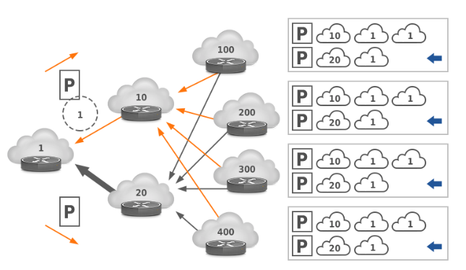
Other BGP Attributes
AS_SET
Instead of a single AS appearing at a slot, it’s a set of Ases
Why?
Prepending
Lengthening the route by adding multiple instances of ASN
Why?
Notes:
AS1 := 10.1.0.0/24
|
AS2 := 10.1.2.0/23 —> Combine AS1 + AS3: 10.1.0.0/23
|
AS3 := 10.1.1.0/24

Slide 26
An example of BGP updates
Advertised IP Prefix
01/01/19 15:03:04|A|218.189.6.2|9304|217.171.93.0/24|9304 6453 701 22351 25395 43256|IGP
The last hop of BGP updates:
AS9304 HGC Global Communications Limited
The owner ASN:
AS43256 Global Broadband Solution Inc
(In Belgium)

Slide 27
Security Challenges?
Any AS can announce ANY IP prefixes
What?

Slide 28
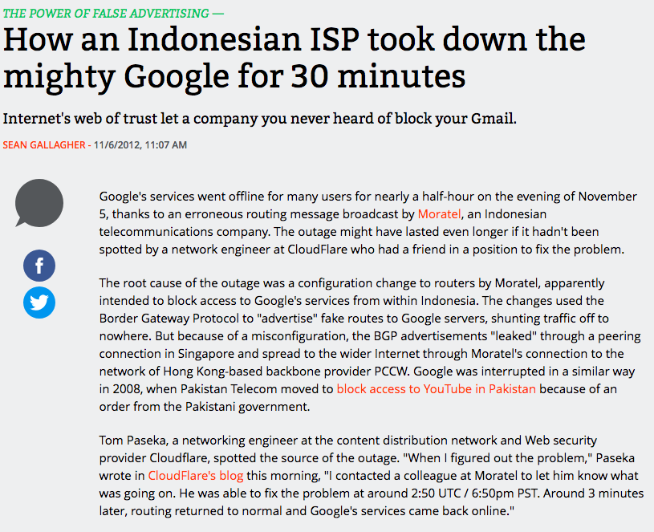
BGP Route leak

Slide 29
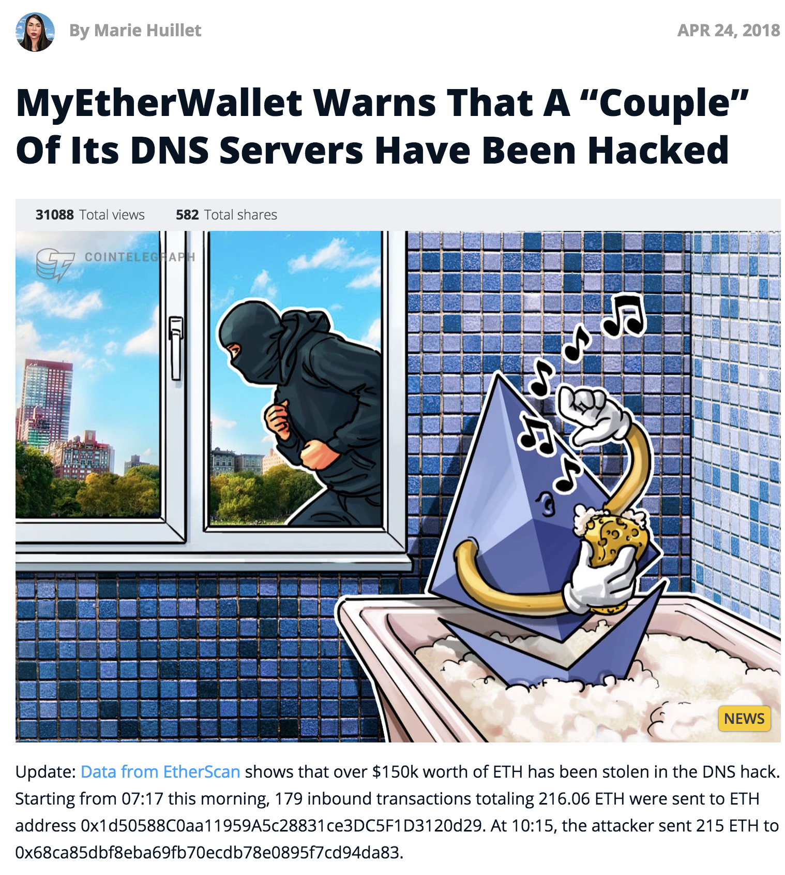
BGP Subprefix Hijacking

Slide 30
Sneak peek of security-related lectures

Slide 31
When you request a webpage (1)
DNS Server
1
Browser
2
Web Server

Slide 32
When you request a webpage (2)
DNS Resolver
3
DNS Server
1
Browser
2
Web Server

Slide 33
Underlying structure
AS 1
AS 2
DNS Resolver
3
DNS Server
BGP
1
BGP
Browser
2
Web Server
BGP
AS 3
AS 4

Slide 35
Underlying structure
AS 1
AS 2
DNS Resolver
3
DNS Server
BGP
1
BGP
Browser
2
Web Server
BGP
AS 3
AS 4

Slide 36
Underlying structure
AS 1
AS 2
205.251.192.0/24
DNS Resolver
3
Myetherwallet
DNS Server
BGP
1
BGP
AS 5
More specific than
205.251.192.0/24
Browser
2
Myetherwallet
Web Server
Malicious DNS Resolver
Malicious
DNS &
Web Server
BGP
BGP
AS 3
AS 4

Slide 37
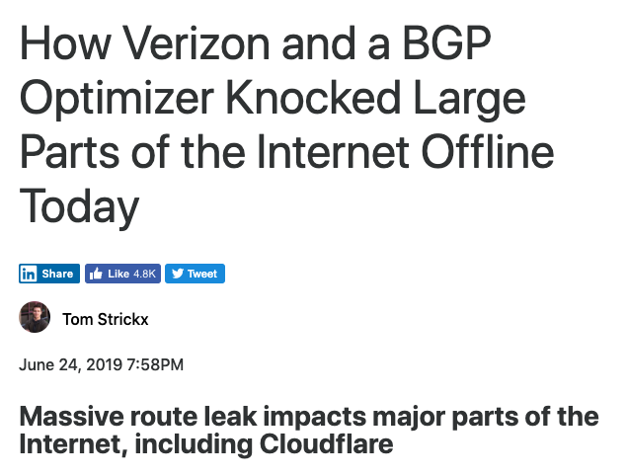
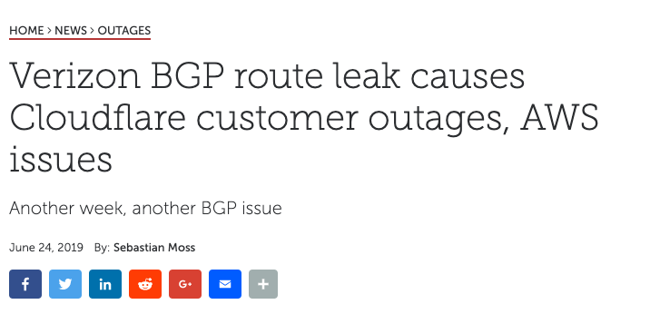
Another Routeleak

Slide 38
Why it happened (from 10,000 ft view)
More details in https://blog.cloudflare.com/how-verizon-and-a-bgp-optimizer-knocked-large-parts-of-the-internet-offline-today/

Slide 39
How can we prevent from these attacks?
Here RPKI (Resource PKI) comes to save you
Cryptographic signature to sign “who” is authorized to announce “which” IP prefixes
(may) talk about this near the end of the semester

Slide 40
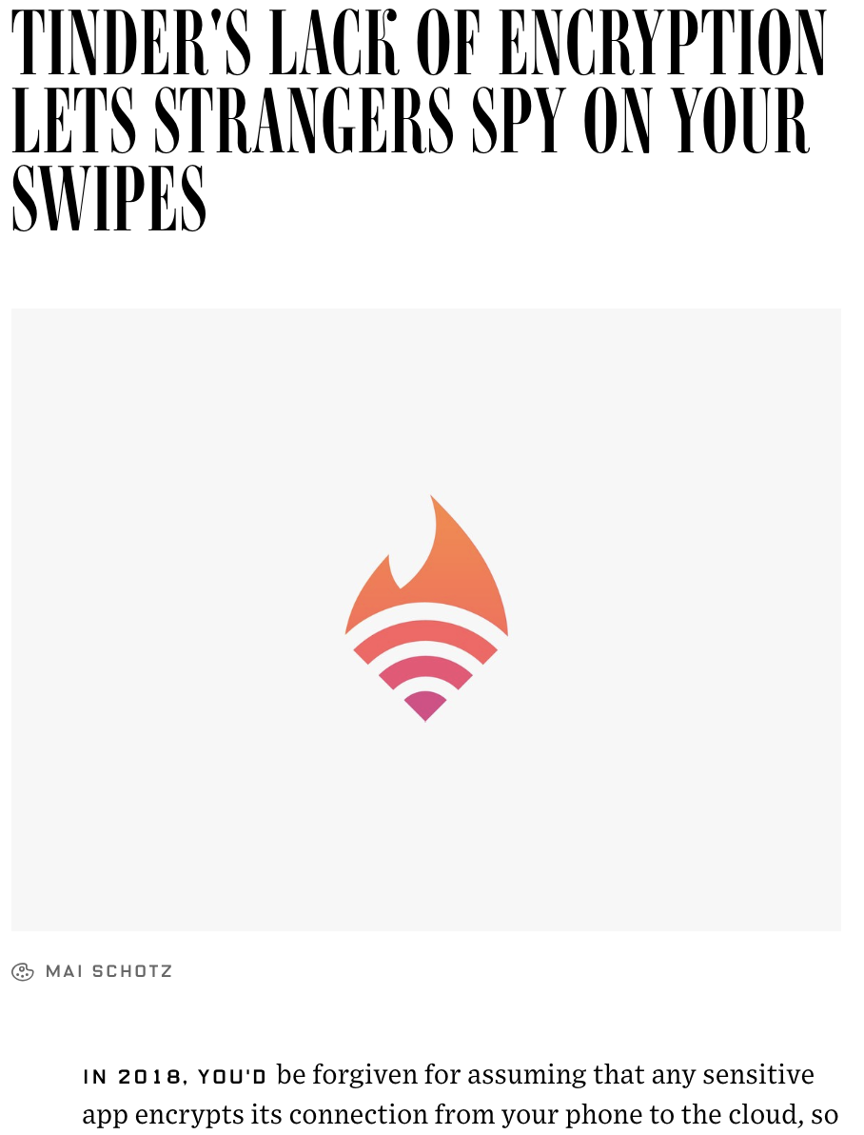
Again
Why this is happening?
Security matters
after it performs very well? (my thoughts)

Slide 41
Again
Why this is happening?
Security matters
after it performs very well? (my thoughts)
Privacy matters
Network Security course CSCI-759 (Topics in System)

